Slide 1



3D Acoustic Levitation Particle Control
By Cristo Lopez Rosas
Arizona State University

Slide 2
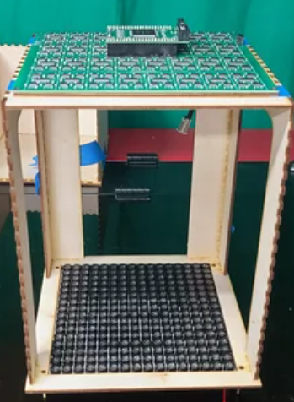
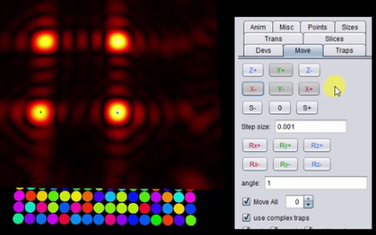
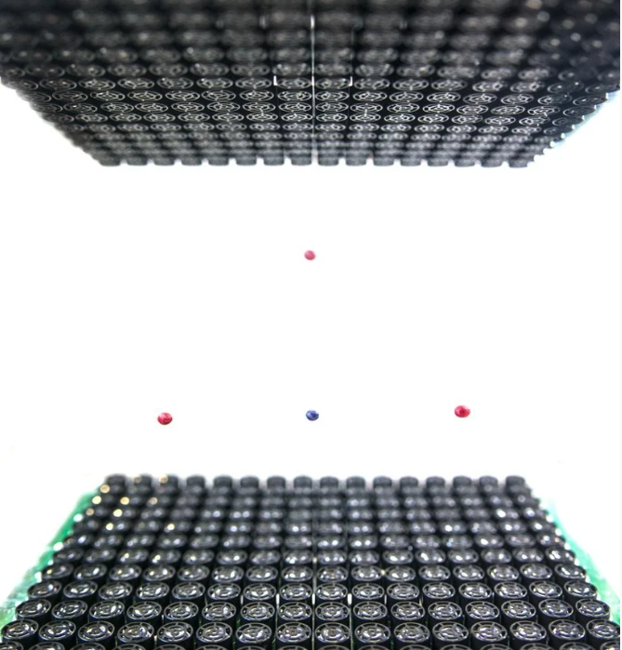
Project Overview
Building a 3D acoustic levitation system (inspired by Instructables designs) to manipulate particles in mid-air.
Microcontroller for system control.
Long-term goal: 3D tissue construction and radiation analysis via acoustic control.

Slide 3
What is Acoustic Levitation?
Transducer
Standing waves: has high/low pressure areas.
Pressure nodes: Trap tiny particles in low pressure.
Phased arrays: allows for precise 3D control.
Contactless manipulation: No physical contact of biological materials.
Node
Anti-Node
Phased Array

Slide 4
Applications for Tissue Engineering
Transducer
Microgravity Simulation: Enables a space-like conditions.
Cell Handling: Levitates cells without any physical contact.
3D Manipulation: Cells can be moved using frequency, phase, or amplitude in 3D.
Environment: Safe and controlled environment for sensitive materials.
Node
Anti-Node
Phased Array

Slide 5
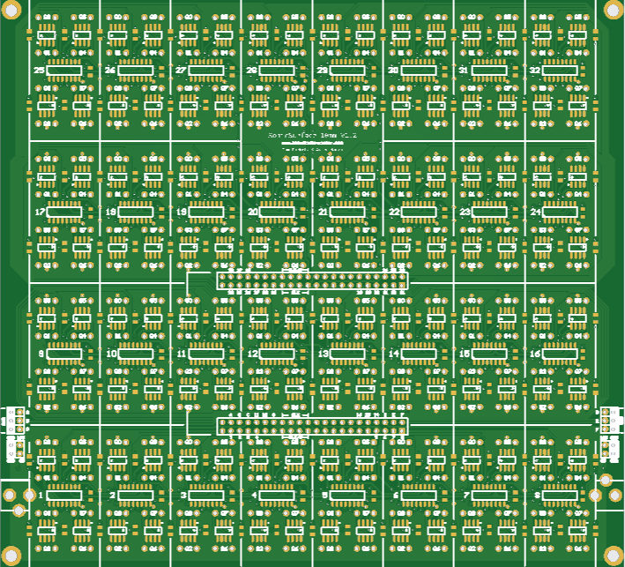
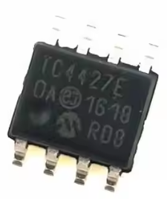
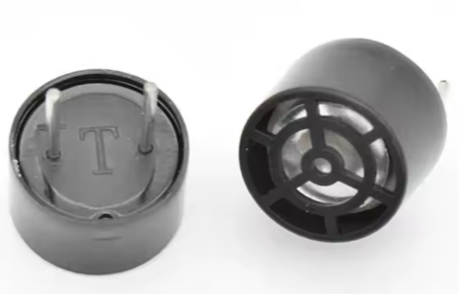

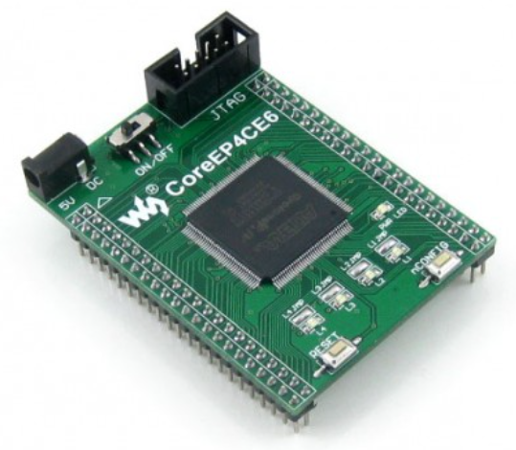
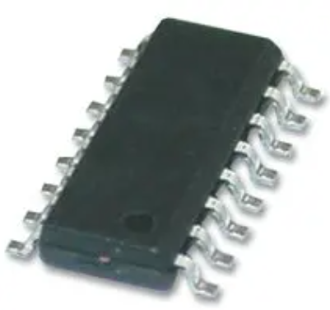

System Development
Hardware Assembly: PCB and electronics integration.
Code Testing: FPGA and microcontroller programming.
Acoustic Testing: Verifying node stability.
Problem Solving: Alignment and electronics debugging.
Driver
Transducer
PCB Board
Shift register
FPGA
Arduino NANO / USB to UART adaptor

Slide 6
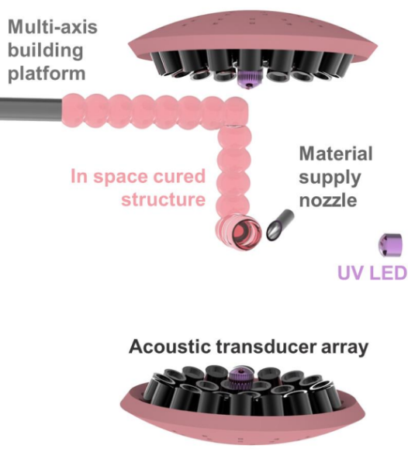
Next Steps: Bioassembly
Investigate acoustic levitation for 3D tissue preparation.
Explore acoustic steering for precise cell and biomaterial assembly.
Develop methods to characterize the resulting 3D tissue constructs.

Slide 7
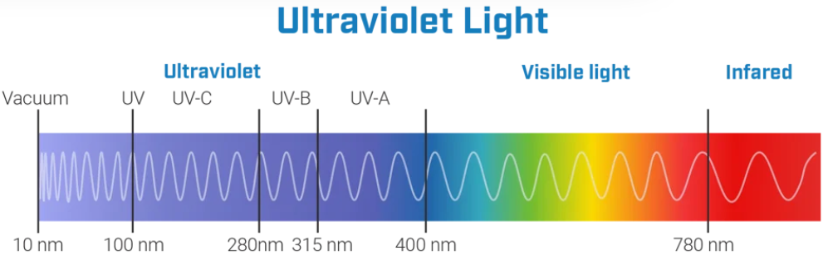
Future Work: Radiation Testing
Simulate various radiation exposure scenarios on 3D tissue models.
Analyze the effects of different radiation intensities on tissue models.

Slide 8
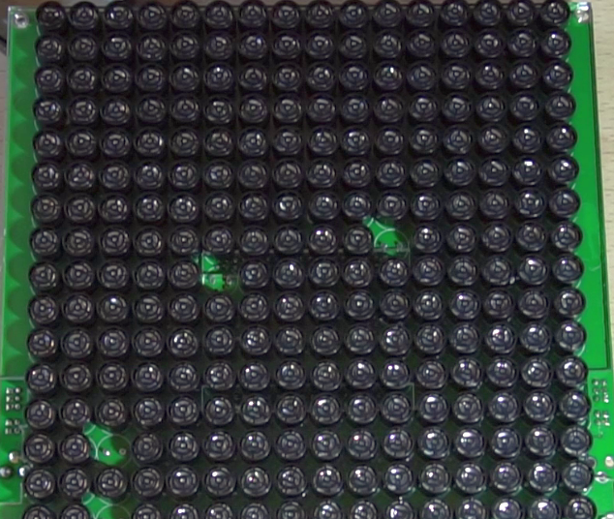
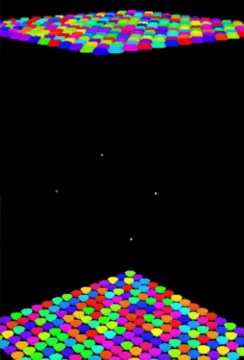
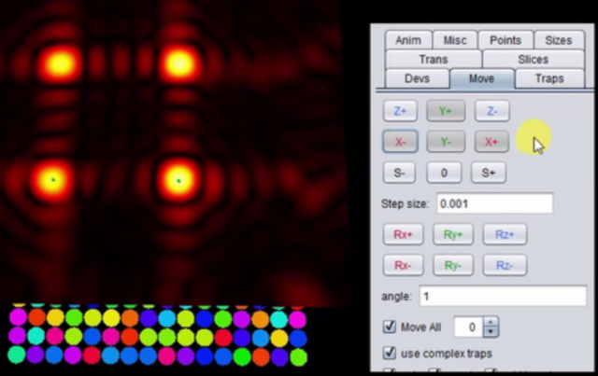
Conclusion
Successfully build and tested a 3D Acoustic Levitation System.
Developed a foundational understanding of sound-based particle manipulation.
Positioned to apply knowledge to future research in 3D tissue bioassembly and radiation effects.

Slide 9
Acknowledgements
Thank you for my mentors Tengteng Tang and Xiangjia (Cindy) Li for supporting me and enabling this research to happen.
I also wanted to thank NASA Space Grant for providing an amazing experience and opportunity to learn and apply real-life skills through research.
Cooperative Agreement 80NSSC20M0041

Slide 10
Thank you!

